Slide 1
Introduction to the programme

Slide 2
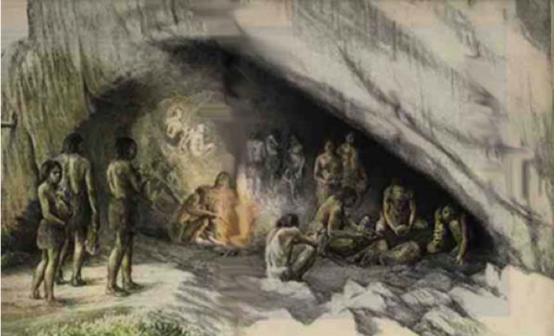
Why is it so hard to lose weight and keep it off?
BIOLOGY
AVOID PAIN AND SEEK PLEASURE
Pain of change
Seeking dopamine
Numbing emotions
© Mind over Body Weight Management 2016

Slide 3
YOUR BRAIN
Two brains fighting each other
a) conscious mind (10%)
b) subconscious mind (90%)
Conscious Mind – logic, goal directed
Subconscious mind – inner critic

Slide 4

SUBCONCIOUS MIND
Inner critic – Chimp on your shoulder
Shaped during our formative years by our environment, family, teachers, friends
Holds our belief system, values, attitudes

Slide 5
Reward based learning system
Trigger – Behaviour - Reward
See some food that looks good
The brain sends signal – eat – survival
Tastes good – makes you feel better - body sends signal to brain to remember
Creative brain – use same principle to feel better
Same process – different trigger – emotion instead of hunger

Slide 6

LEARNING A NEW SKILL NEEDS PRACTICE

Slide 7


CREATING NEW PATHS IN YOUR BRAIN

Slide 8


Slide 9


NUTRITION
Notes:
Understanding why, how to use mind, tools to take away

Slide 10
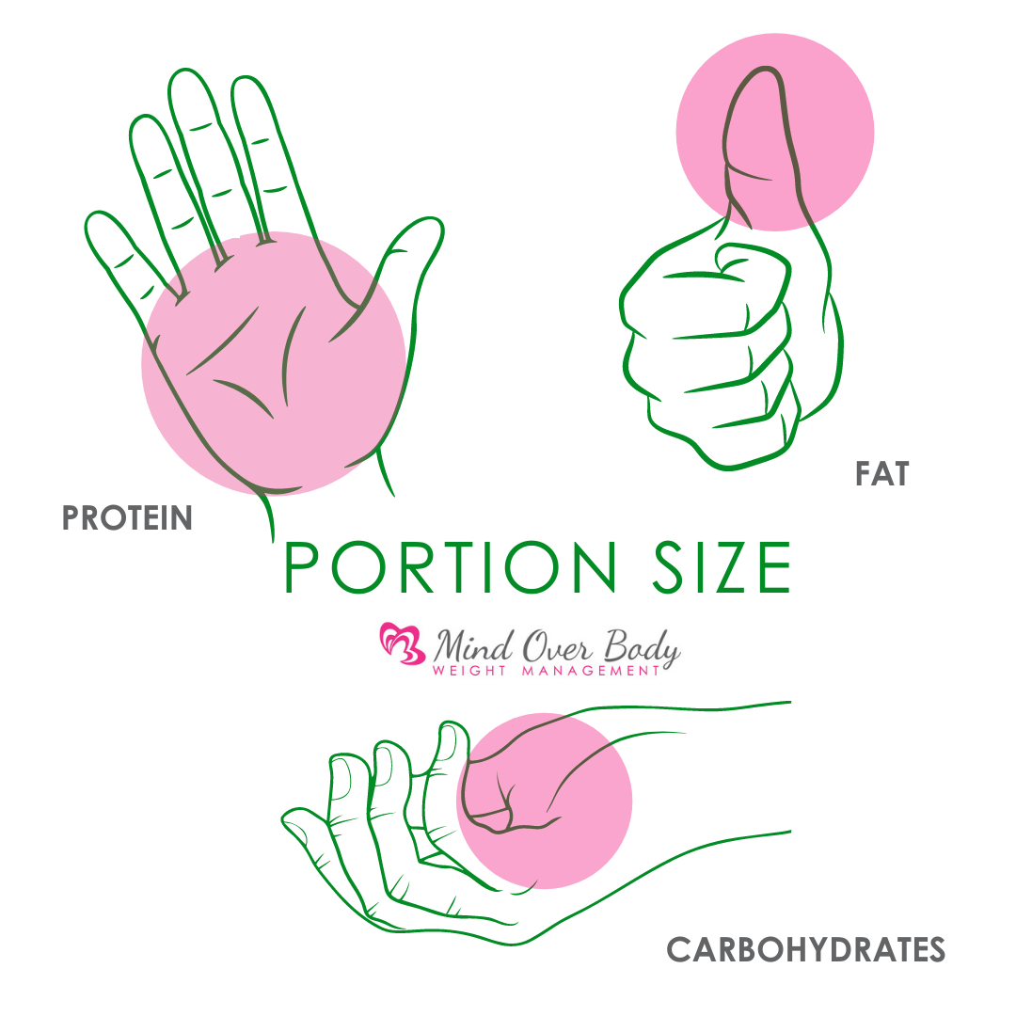

Slide 11
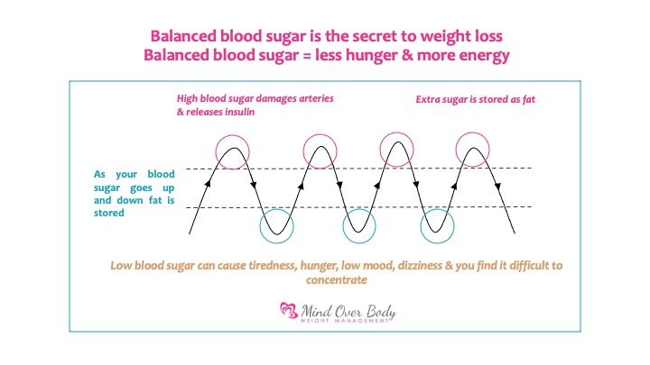

Slide 12

How to keep your blood sugar balanced
Eat 3 meals and 1 or 2 snacks a day
Eat some good quality protein & essential fats at each meal & snack
Reduce starchy carbs such as pasta, bread, rice, etc.

Slide 13
YOUR HEALTHY EATING GUIDELINES
Eat 3 main meals and 2 snacks per day
EAT EVERY 3 HOURS (approx.)
Drink 2l of water per day
Add a source of protein to every meal & snack
Fill half your plate with vegetables or salad & halpf with protein
Eat mostly fresh products
REDUCE STARCHY CARBOHYDRATES (bread, pasta, rice, potatoes etc., When eating choose brown variety/whole meal)
Aim to eat starchy carbohydrates only after exercising & avoid at evening meals
Limit alcohol to every second week
Follow the guidelines 90% of the time

Slide 14
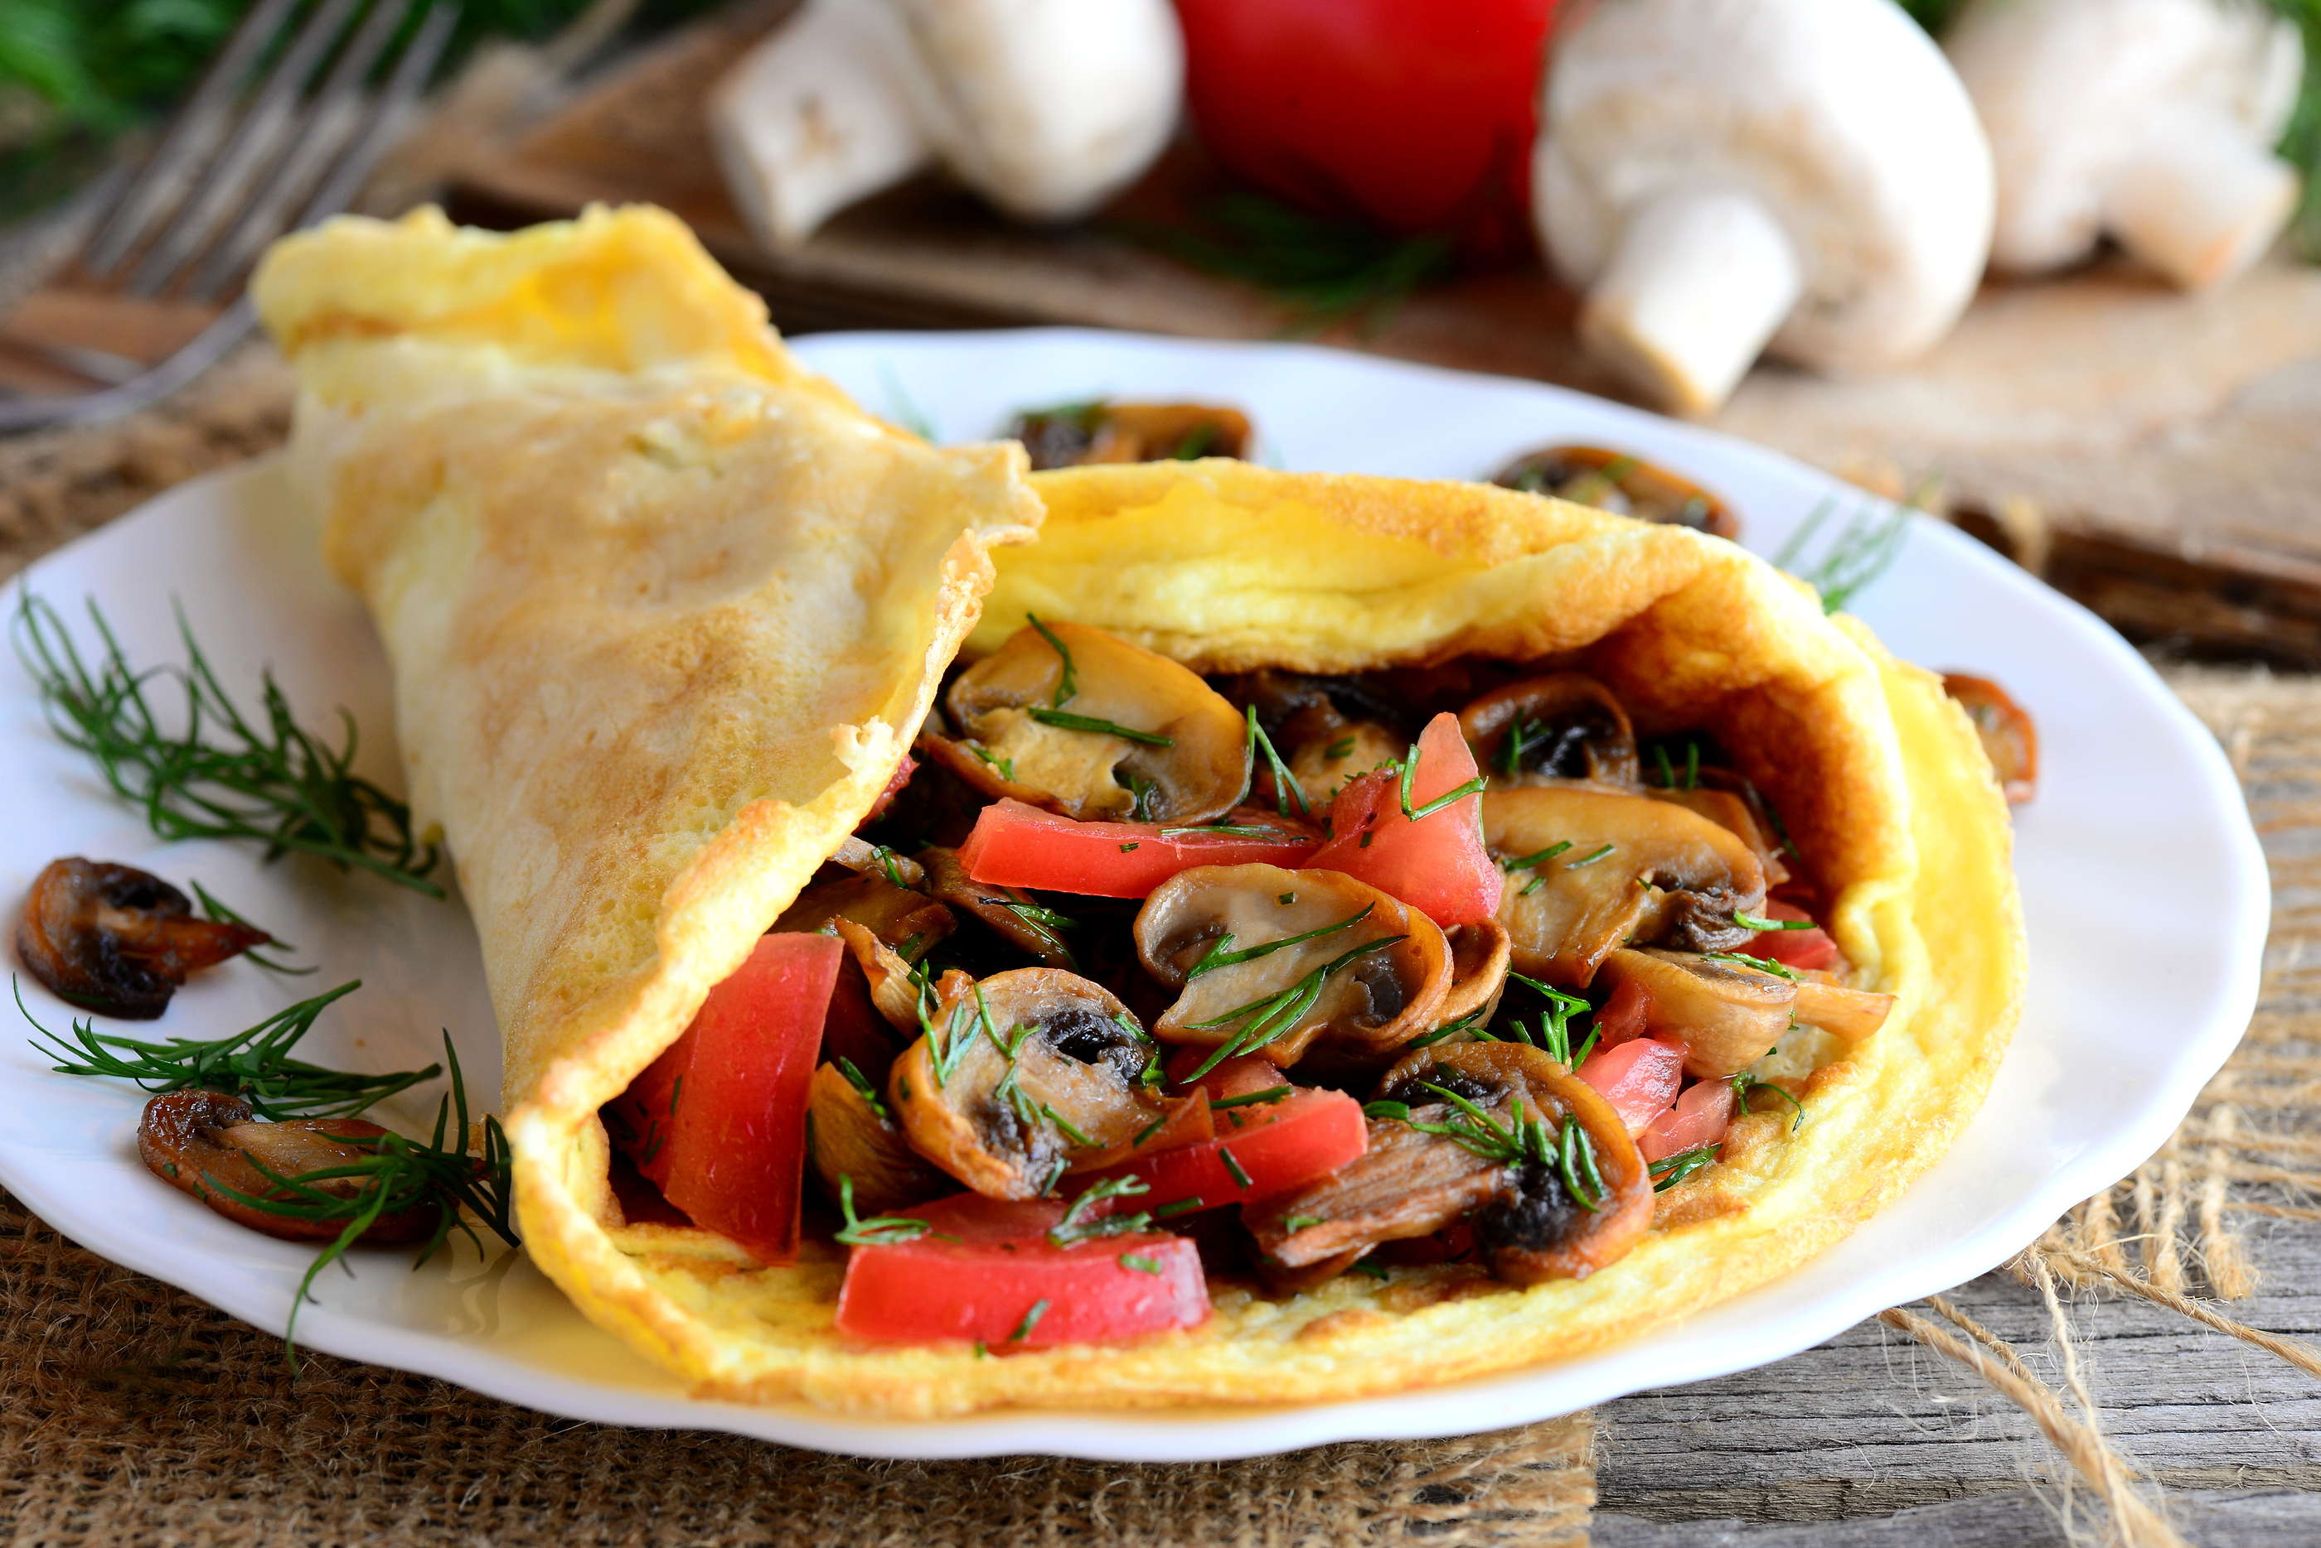
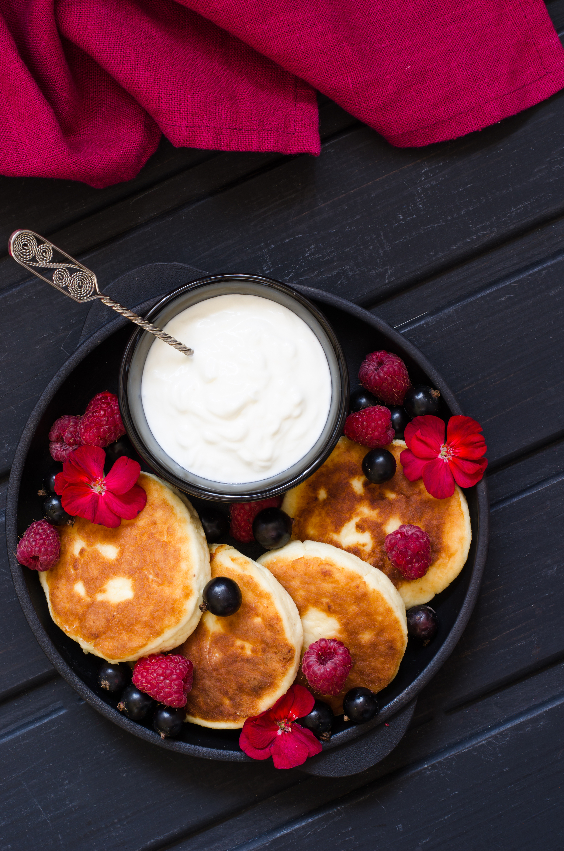
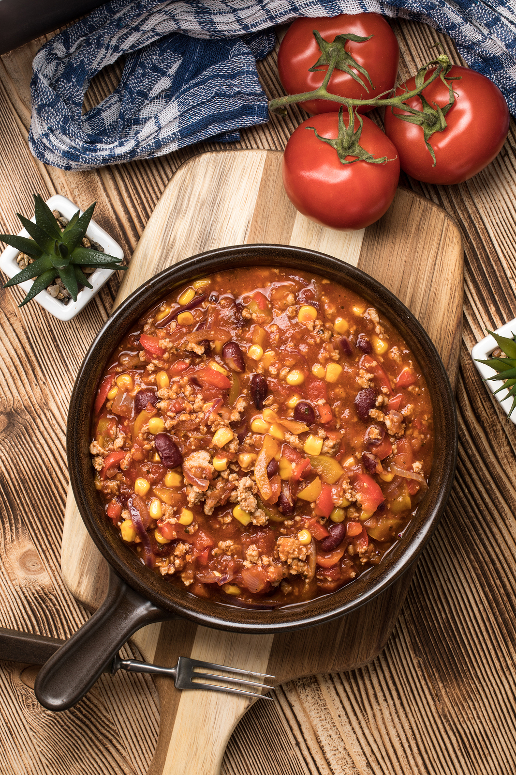
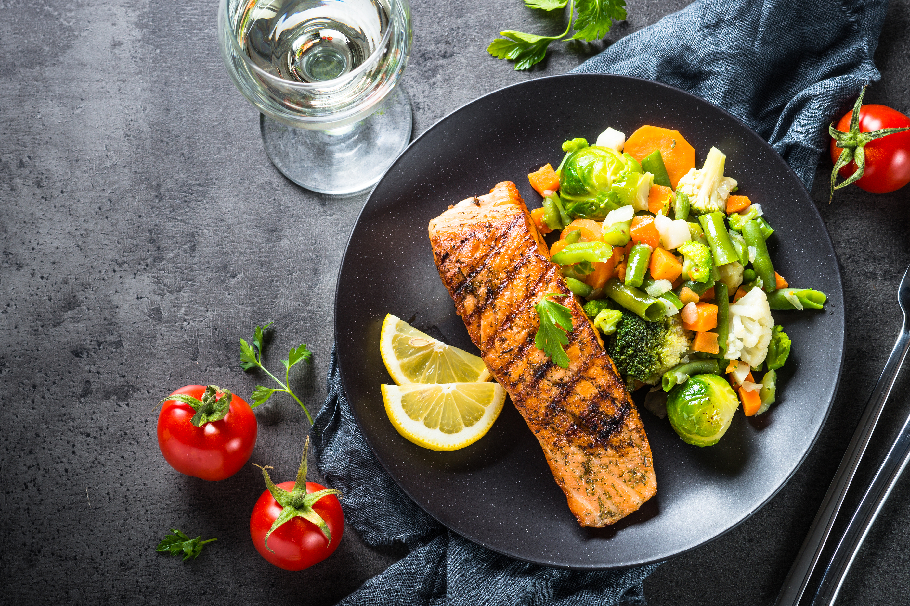
MAIN MEALS
Consist of:
Protein (Chicken/egg/fish/meat etc)
PLUS
Salad and/or vegetables

Slide 15
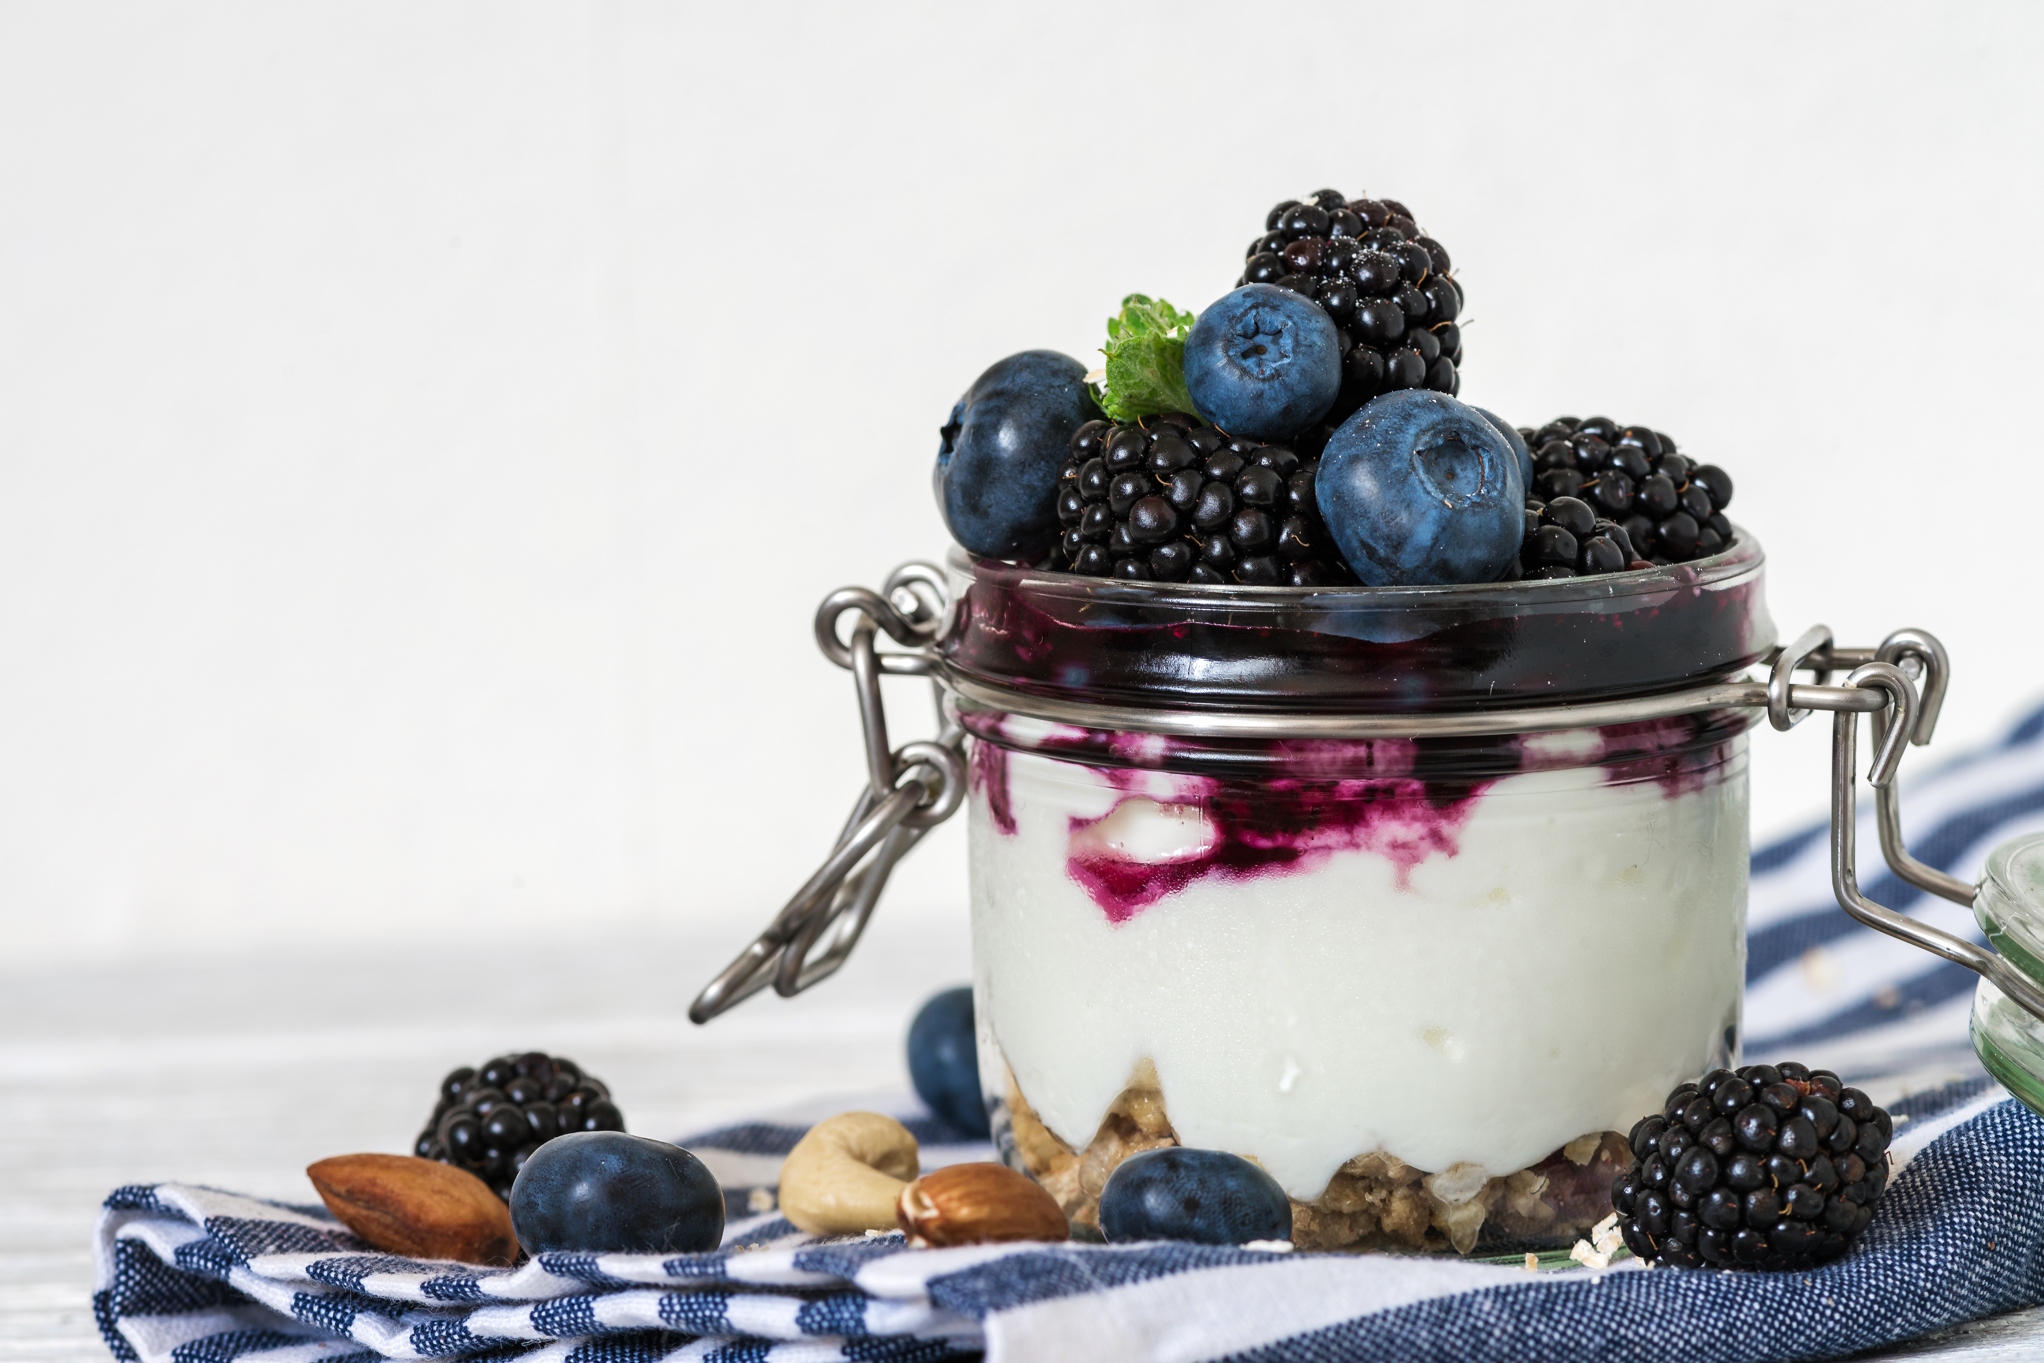
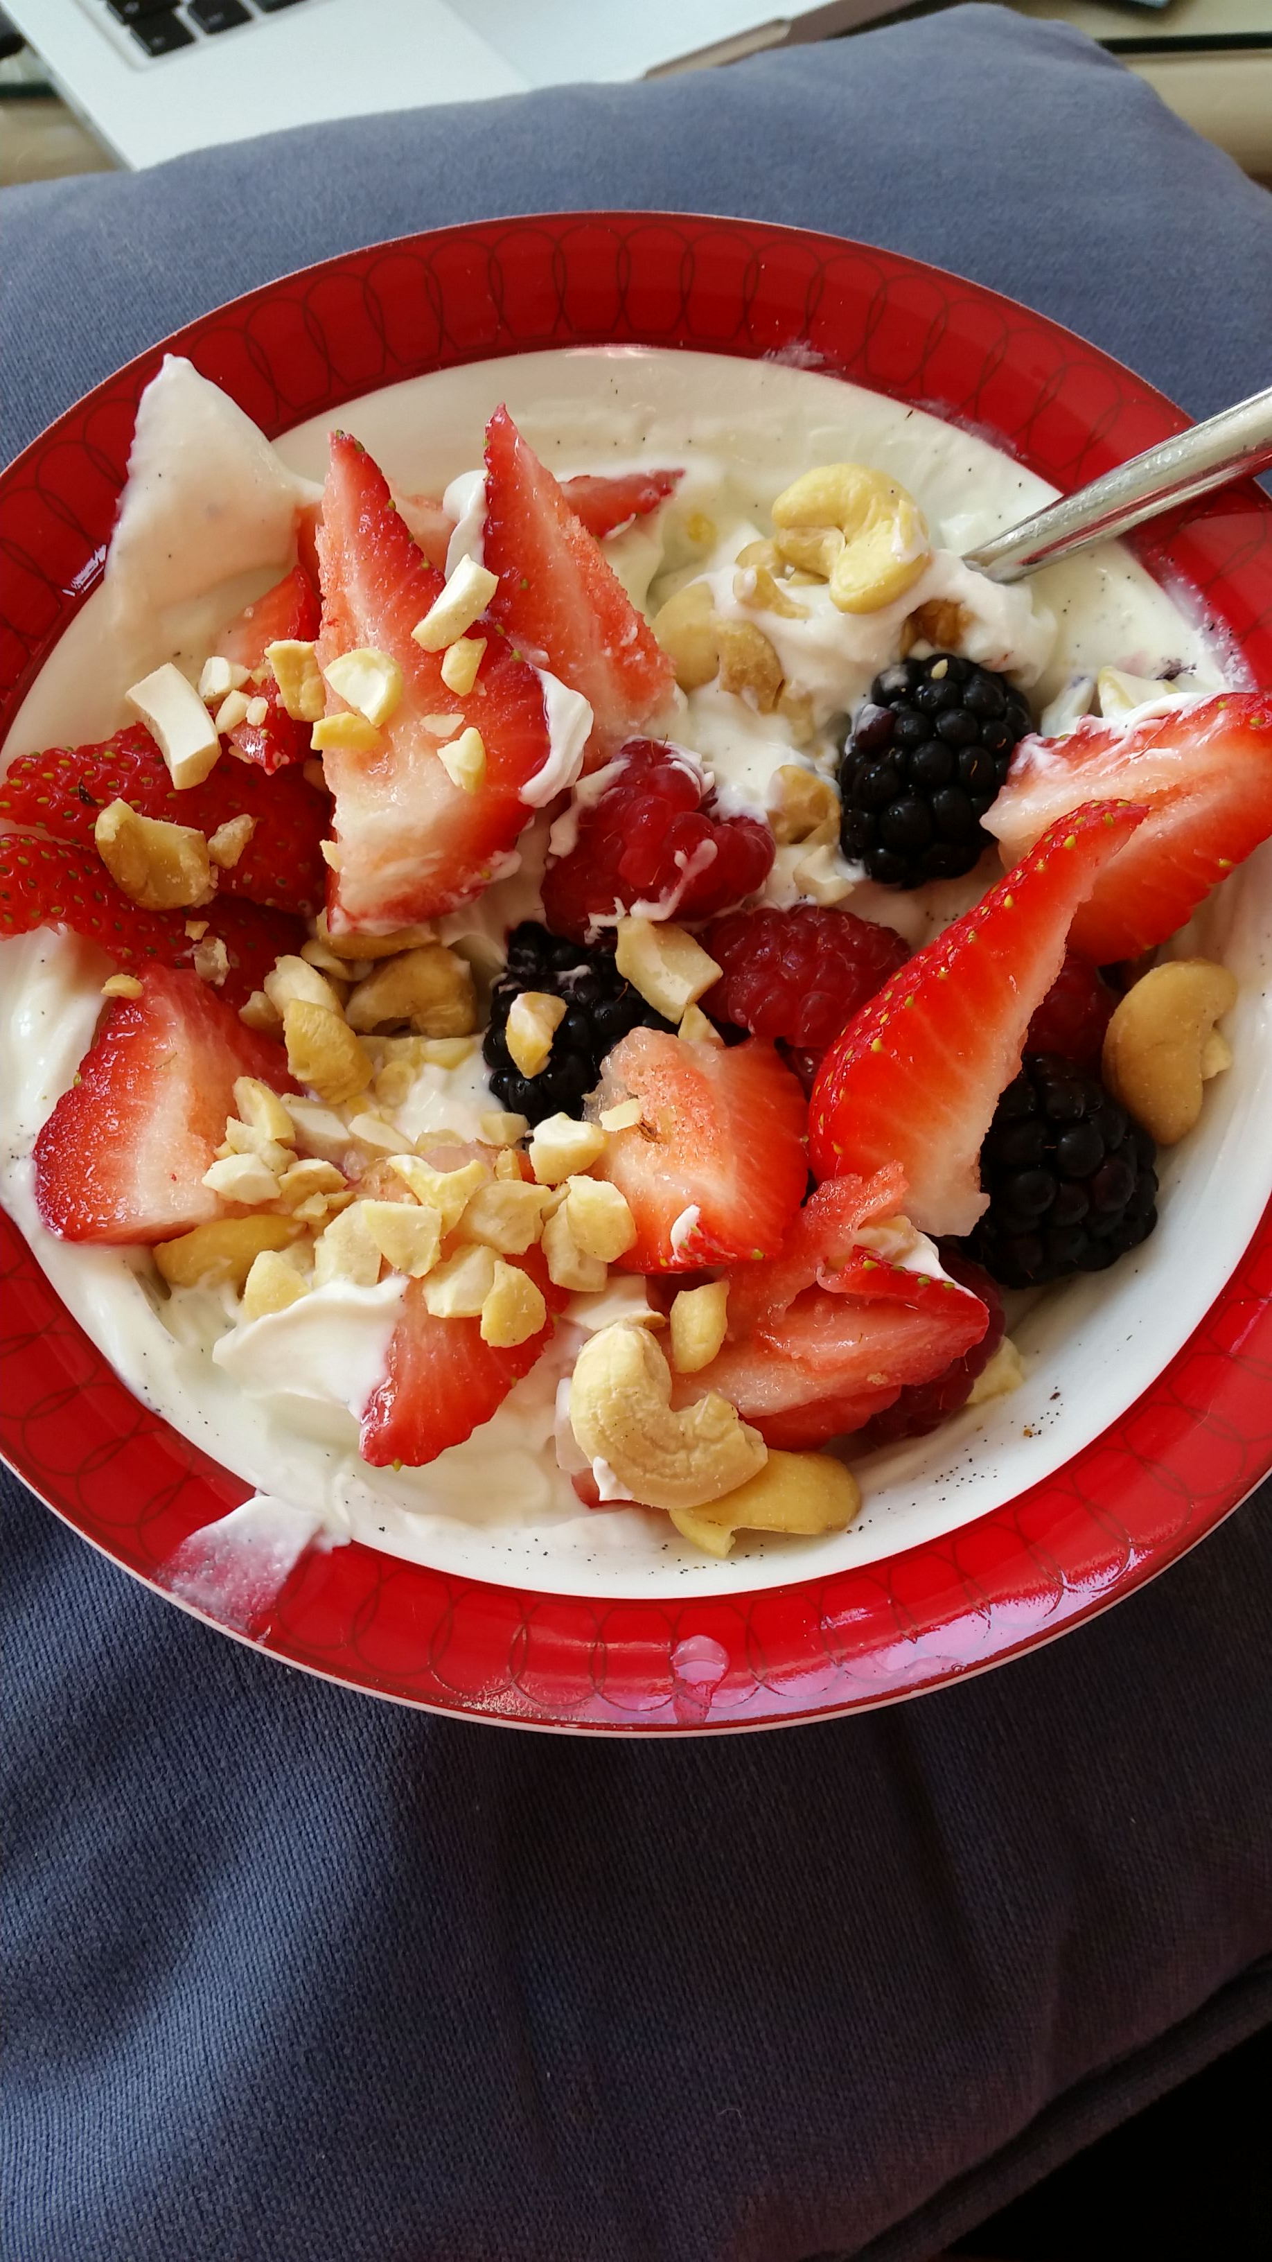
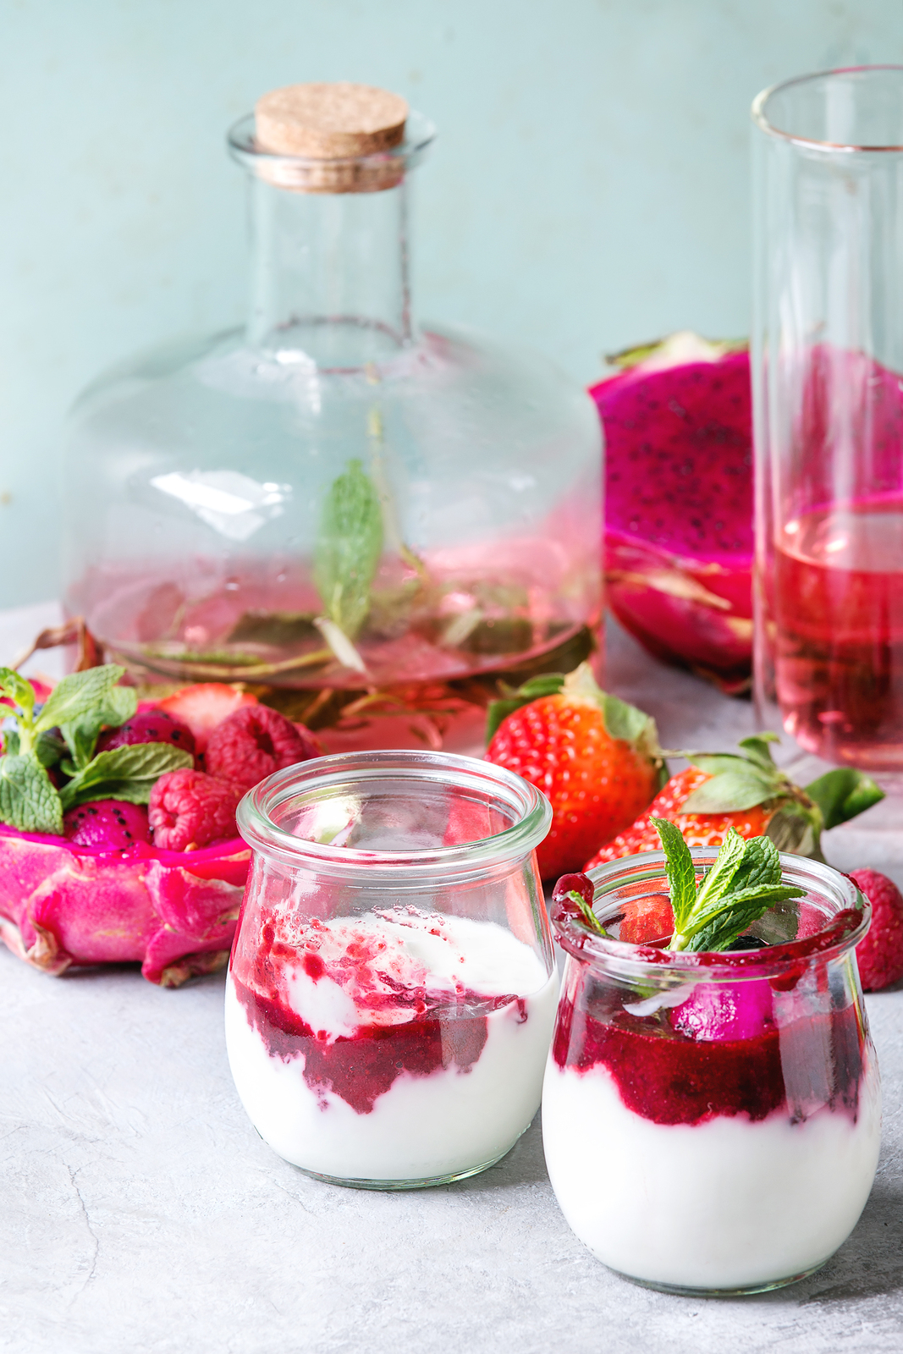
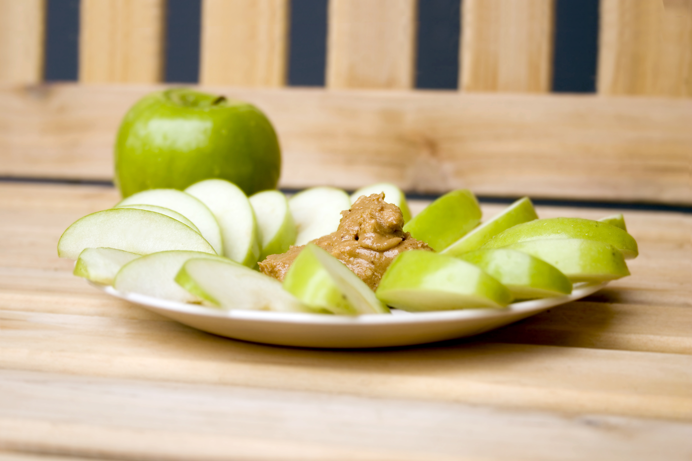
SNACKS
For example:
Protein: Greek Style Yogurt/Quark
plus
1 piece of fruit
plus
Unsalted raw nuts (approx. 8)
or 2 teaspoons nutbutter

Slide 16
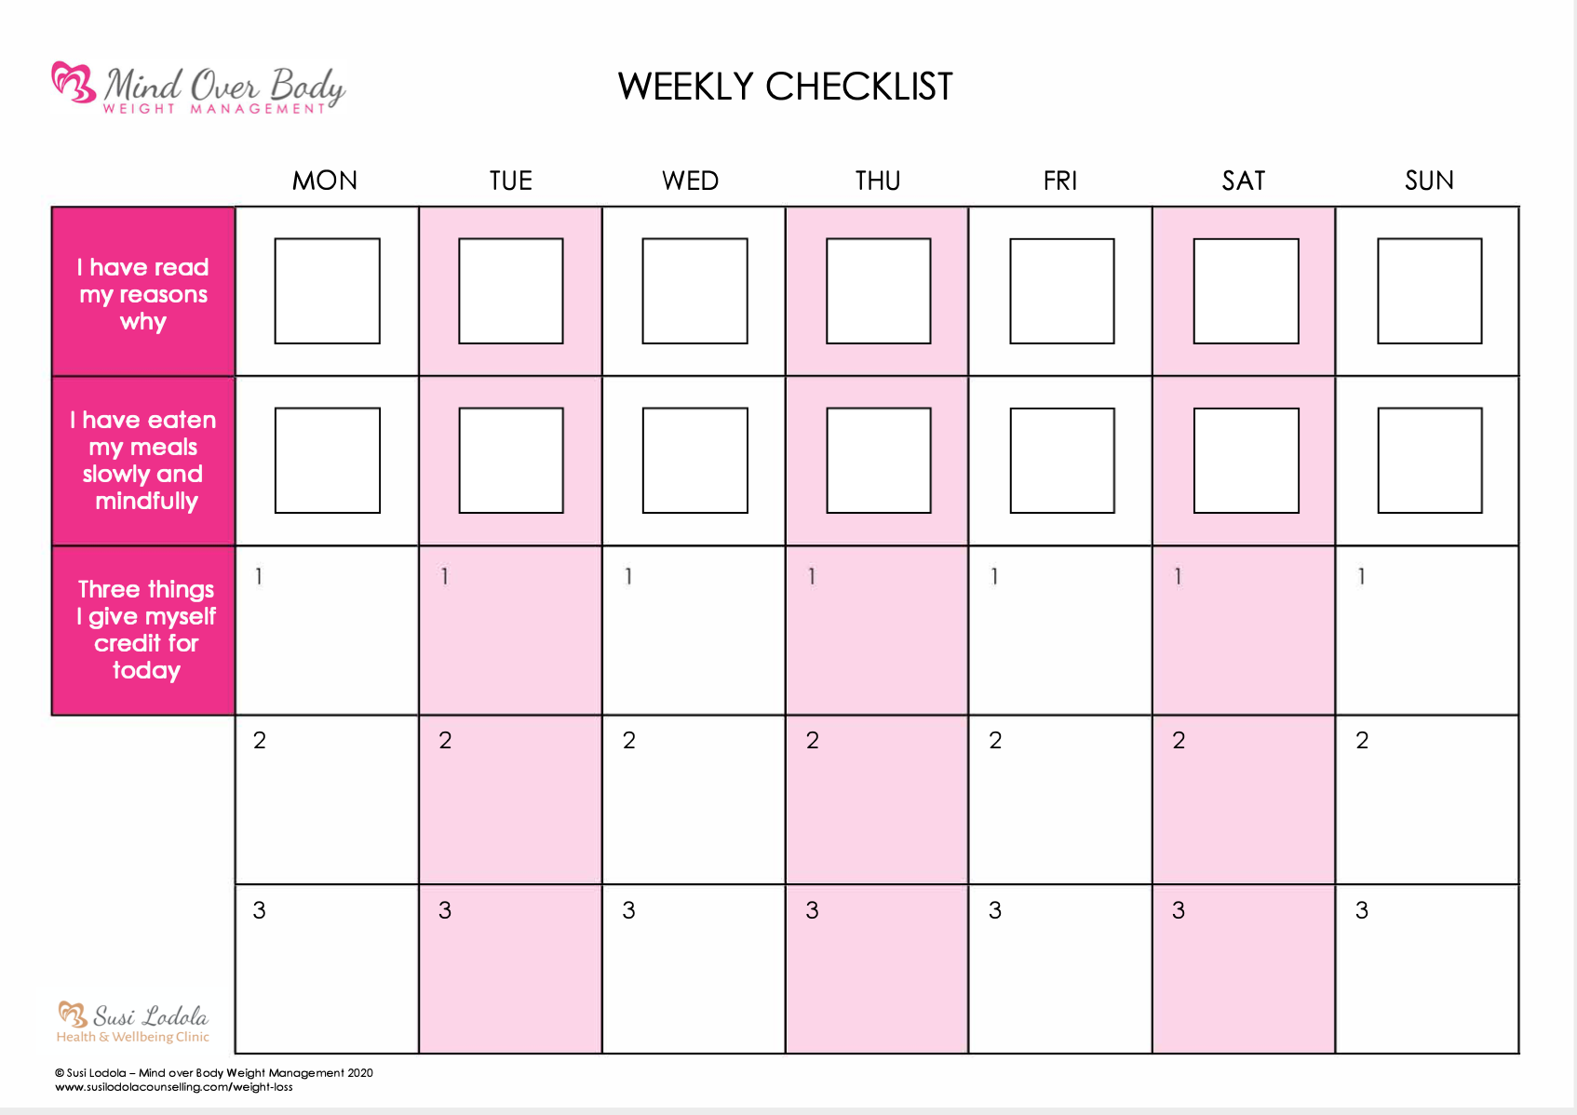
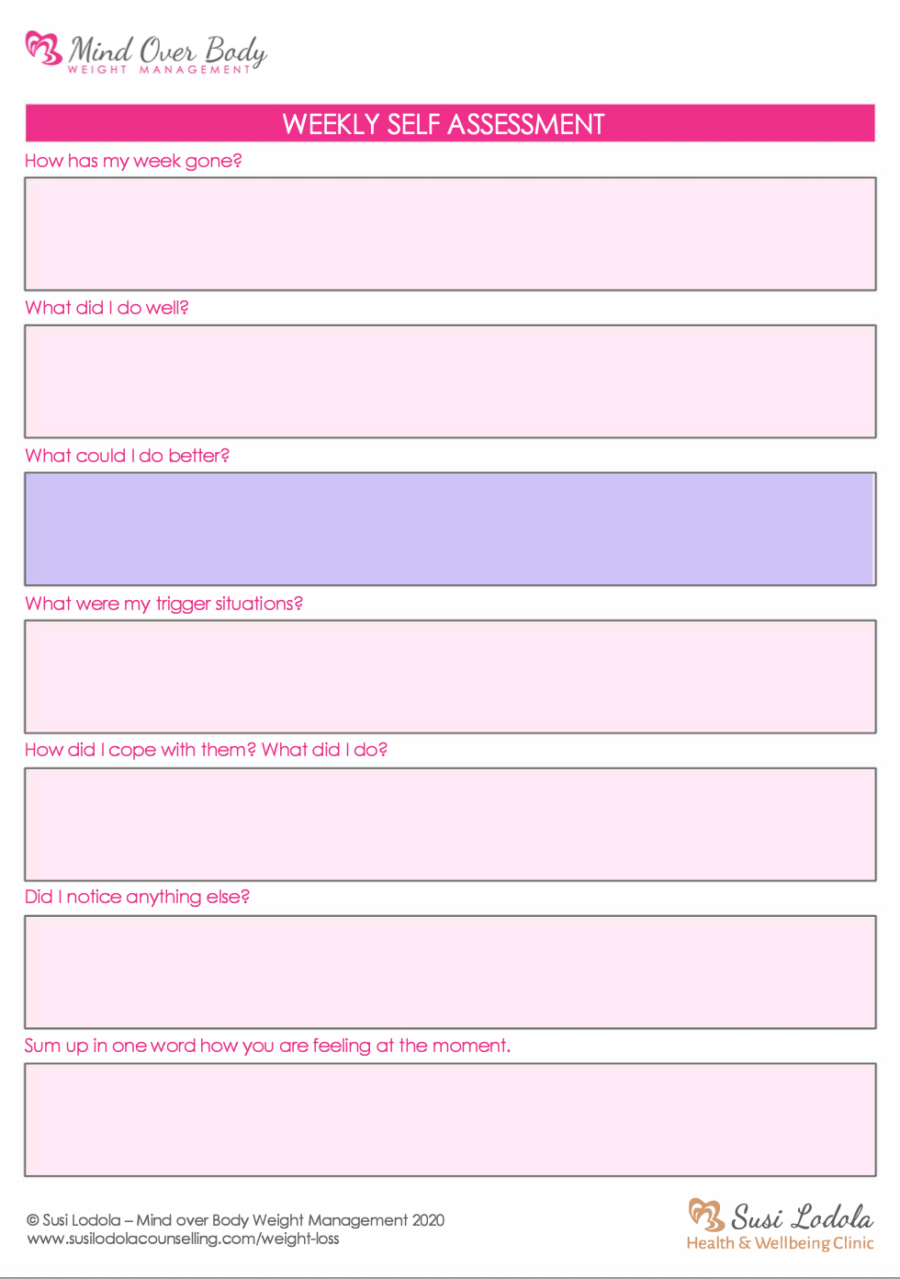
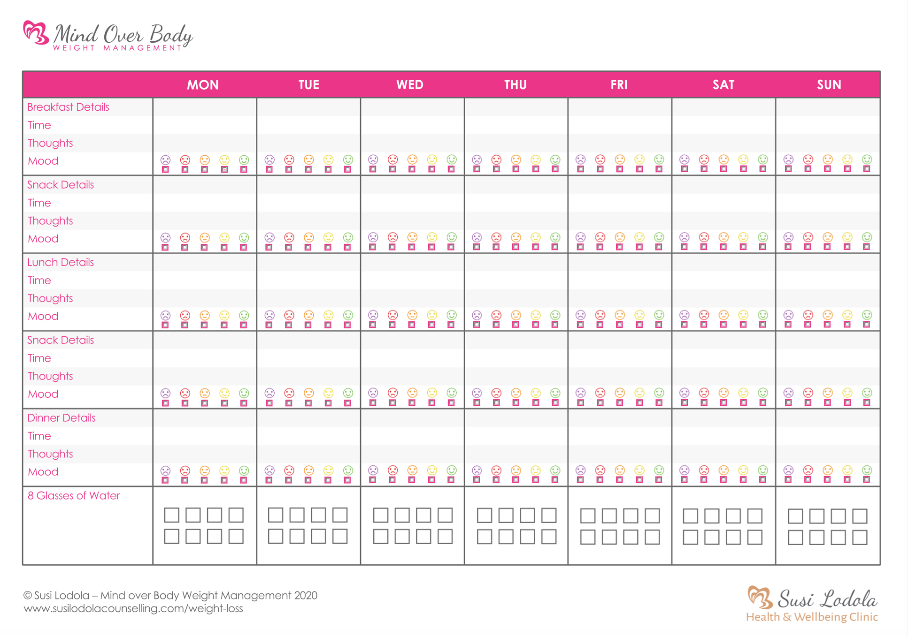
Weekly worksheets
Notes:
Understanding why, how to use mind, tools to take away

